Slide 1


Balanced scorecard slide 1
Airline Safety Analysis
Fly America Airlines
Swetha Chamala
This Photo by Unknown Author is licensed under CC BY-SA

Slide 2
Balanced scorecard slide 2
Overview
Looking back
Safety
Financial data
Fuel Consumption
Affordability
Conclusions

Slide 3
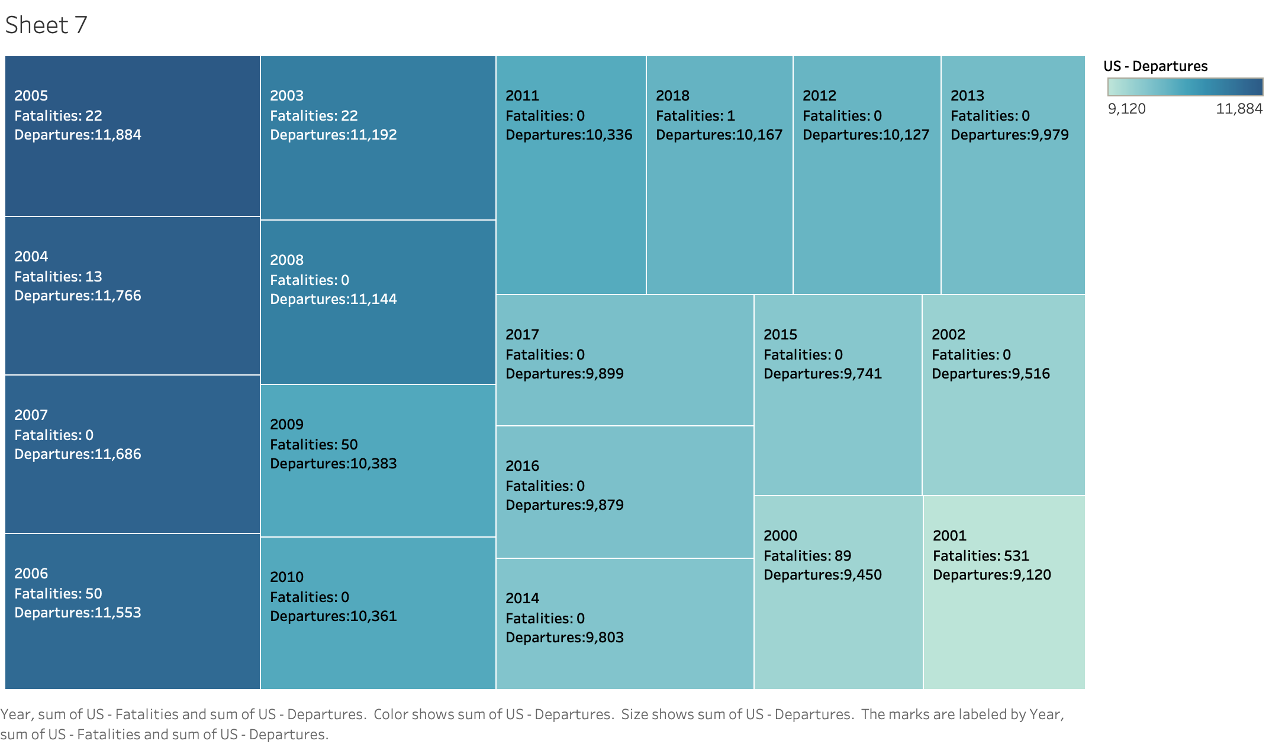
Balanced scorecard slide 4
Looking Back – US airlines Fatalities by number of departures 2000 - 2018
In the US, fatalities
compared to the number
of departure
flights is minimal

Slide 4
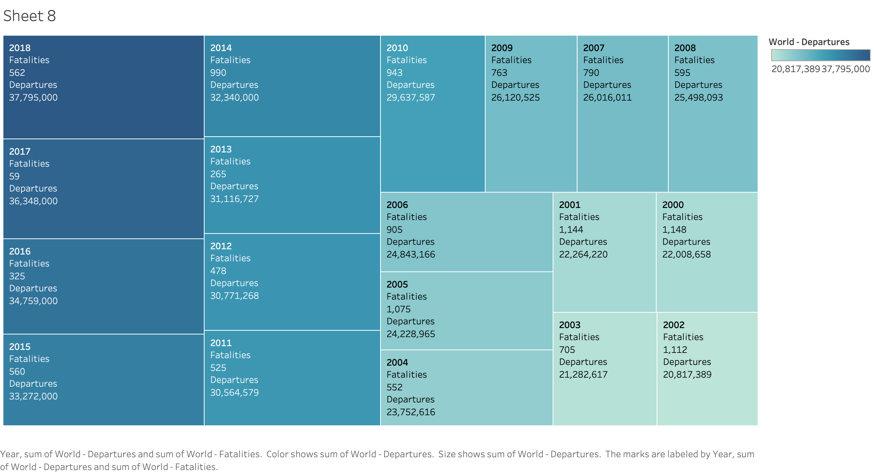
Balanced scorecard slide 4
Looking Back – World airlines Fatalities by number of departures 2000 - 2018
Both the US and World airlines data show that airlines are the safest and fastest method to travel from one place to another

Slide 5
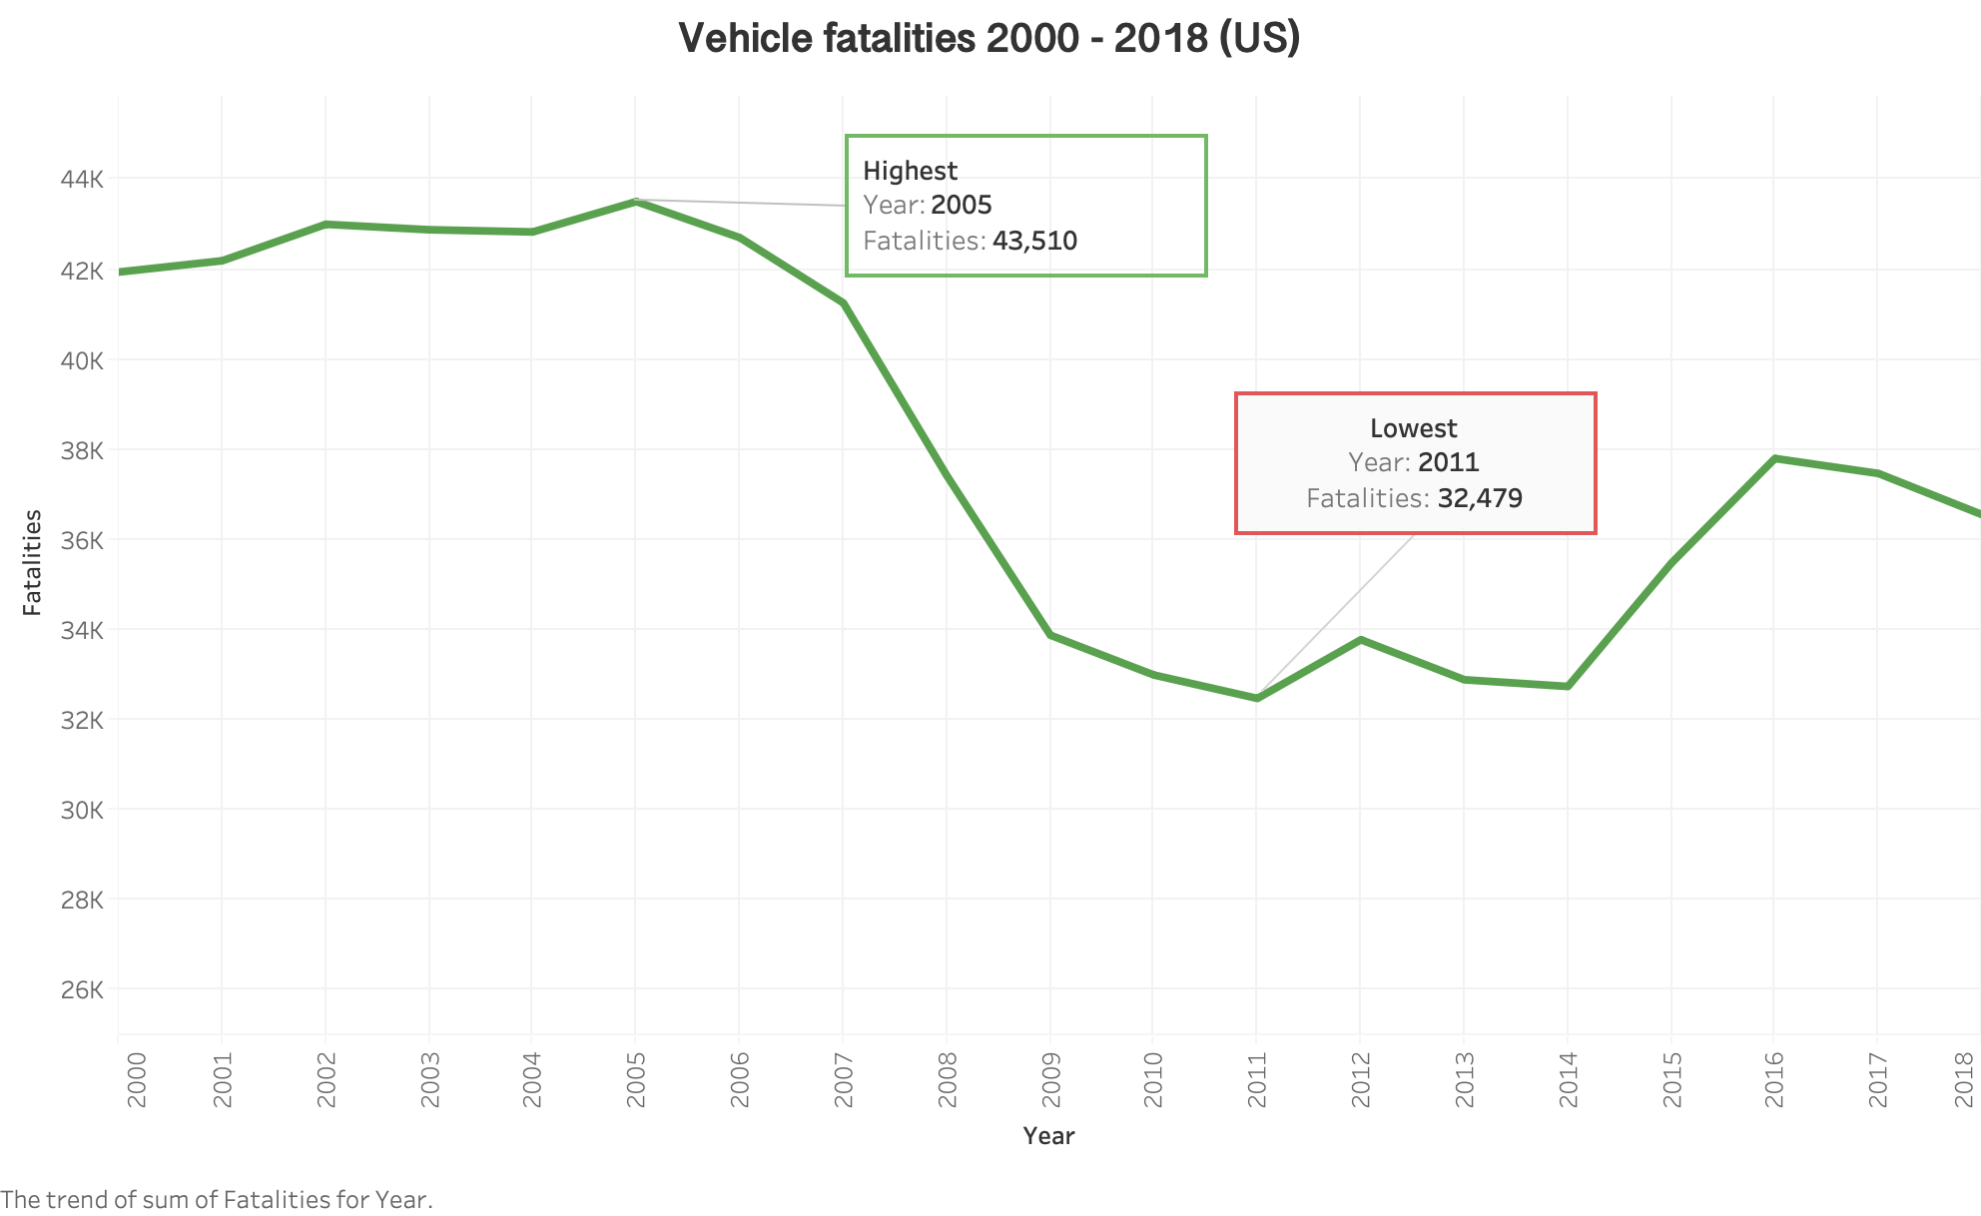

Slide 6


Balanced scorecard slide 2
Which is safer? – Flying or Driving
723869
Total fatalities: year 2000 - 2018
778
Data from NTHSA (National Highway Traffic Safety Administration), Aviation Safety Network and Airlines for America shows that from the years 2000-2018, Vehicle fatalities in the US are over 900 fold more than airline fatalities.

Slide 7
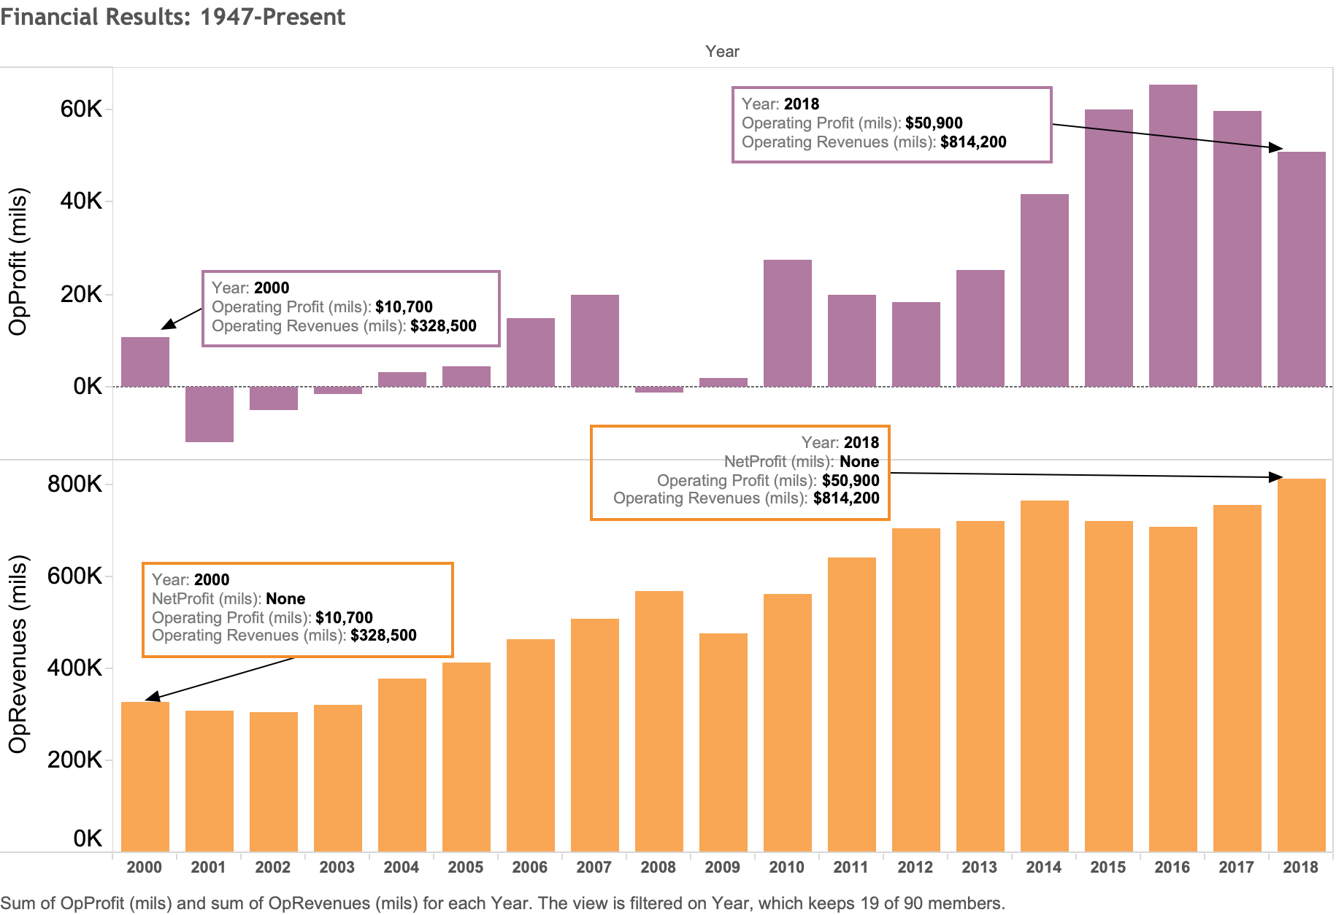
Balanced scorecard slide 4
Financial results – World airlines Net profits from 2000 - 2018
Operational profits and revenues of world airlines have seen a steady increase from 2000 – 2018

Slide 8
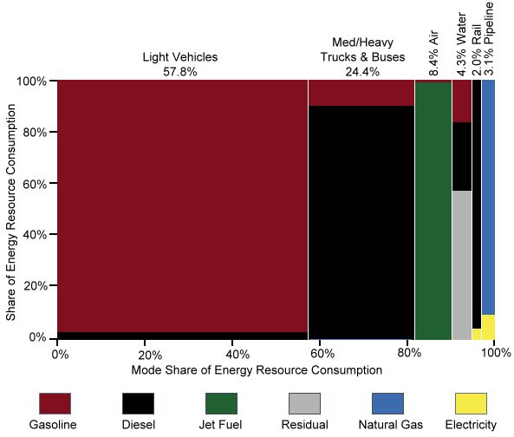
Domestic Consumption of Transportation Energy by Mode and Fuel Type, 2017

Slide 9
Balanced scorecard slide 4
Airfare
How affordable is air travel?
Air travel is much affordable now compared to 77 years ago.
With increasing number of airlines, number of operating flights and more destinations, airline travel affordability has increased.
Boston – Los Angeles | 1941 | 2018
Airfare | $4810 | $427
Hours | 15 | 6
Stops | 12 | 0
Time
Stops

Slide 10
Balanced scorecard slide 4
Affordability
Domestic round-trip airfare
did not change much in comparison
to other expenses over the years

Slide 11

Balanced scorecard slide 5
Conclusion
The total US airline fatalities from 2000-2018 are 778 and World airlines fatalities during the same years are 13,496. That is a 7-fold difference. However, total fatalities caused by driving vehicles in US from 2000-2018 are 723,869. That is roughly 900 times more fatalities compared to airline fatalities in US. There is a clear distinction that vehicle fatalities are higher.
Statistics show that among the many modes of travel, Air travel is the safest.
With the advancement of technology in the aviation industry, air travel has evolved in many ways
Strict airline regulations and improvements in air traffic control technology have ensured additional safety to travel around the world

Slide 12

Balanced scorecard slide 10
This Photo by Unknown Author is licensed under CC BY-SA

